Slide 1


Architecture Choice
Shipboard Power System Fundamentals
Revision of 2 January 2026
Dr. Norbert Doerry
http://doerry.org/norbert/MarineElectricalPowerSystems/index.htm
© 2026 by Norbert Doerry
This work is licensed via: CC BY 4.0 (https://creativecommons.org/)

Slide 2
Essential Questions
How does one choose the electrical and propulsion architecture types? | Apply
How does one design the power and propulsion system networks? | Apply
How does one pick between a.c. and d.c. buses for different parts of the architecture? | Apply
How does one choose the voltage level of buses? | Apply

Slide 3
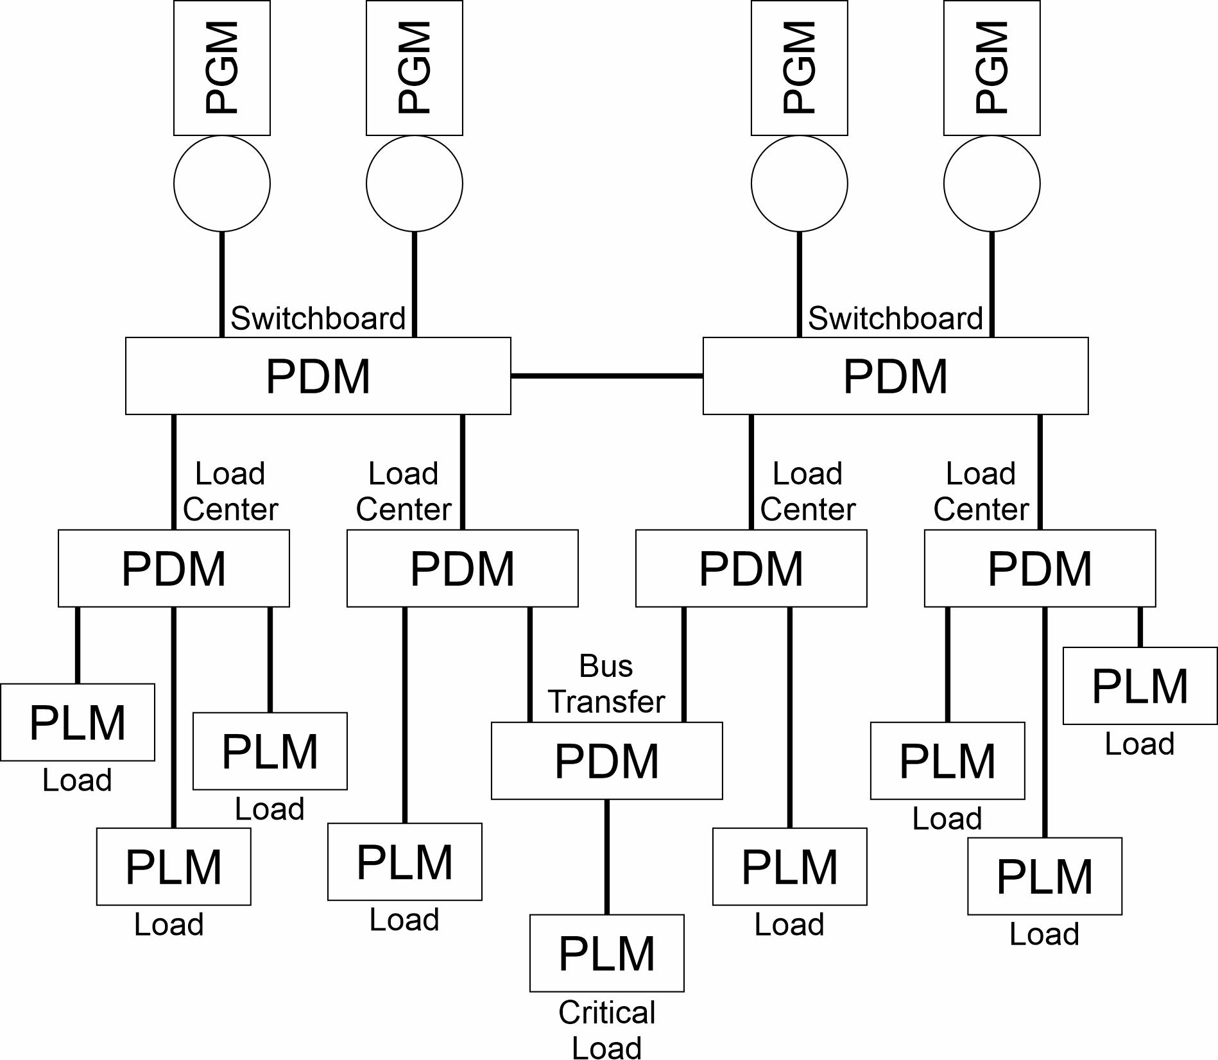
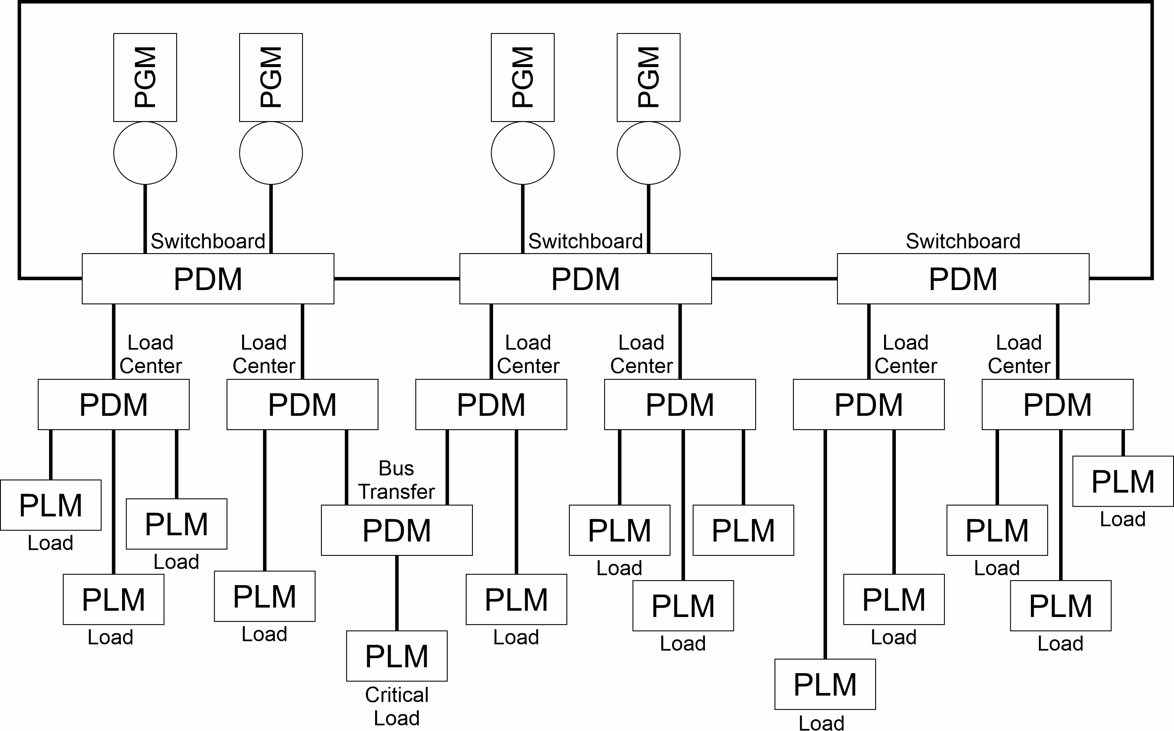
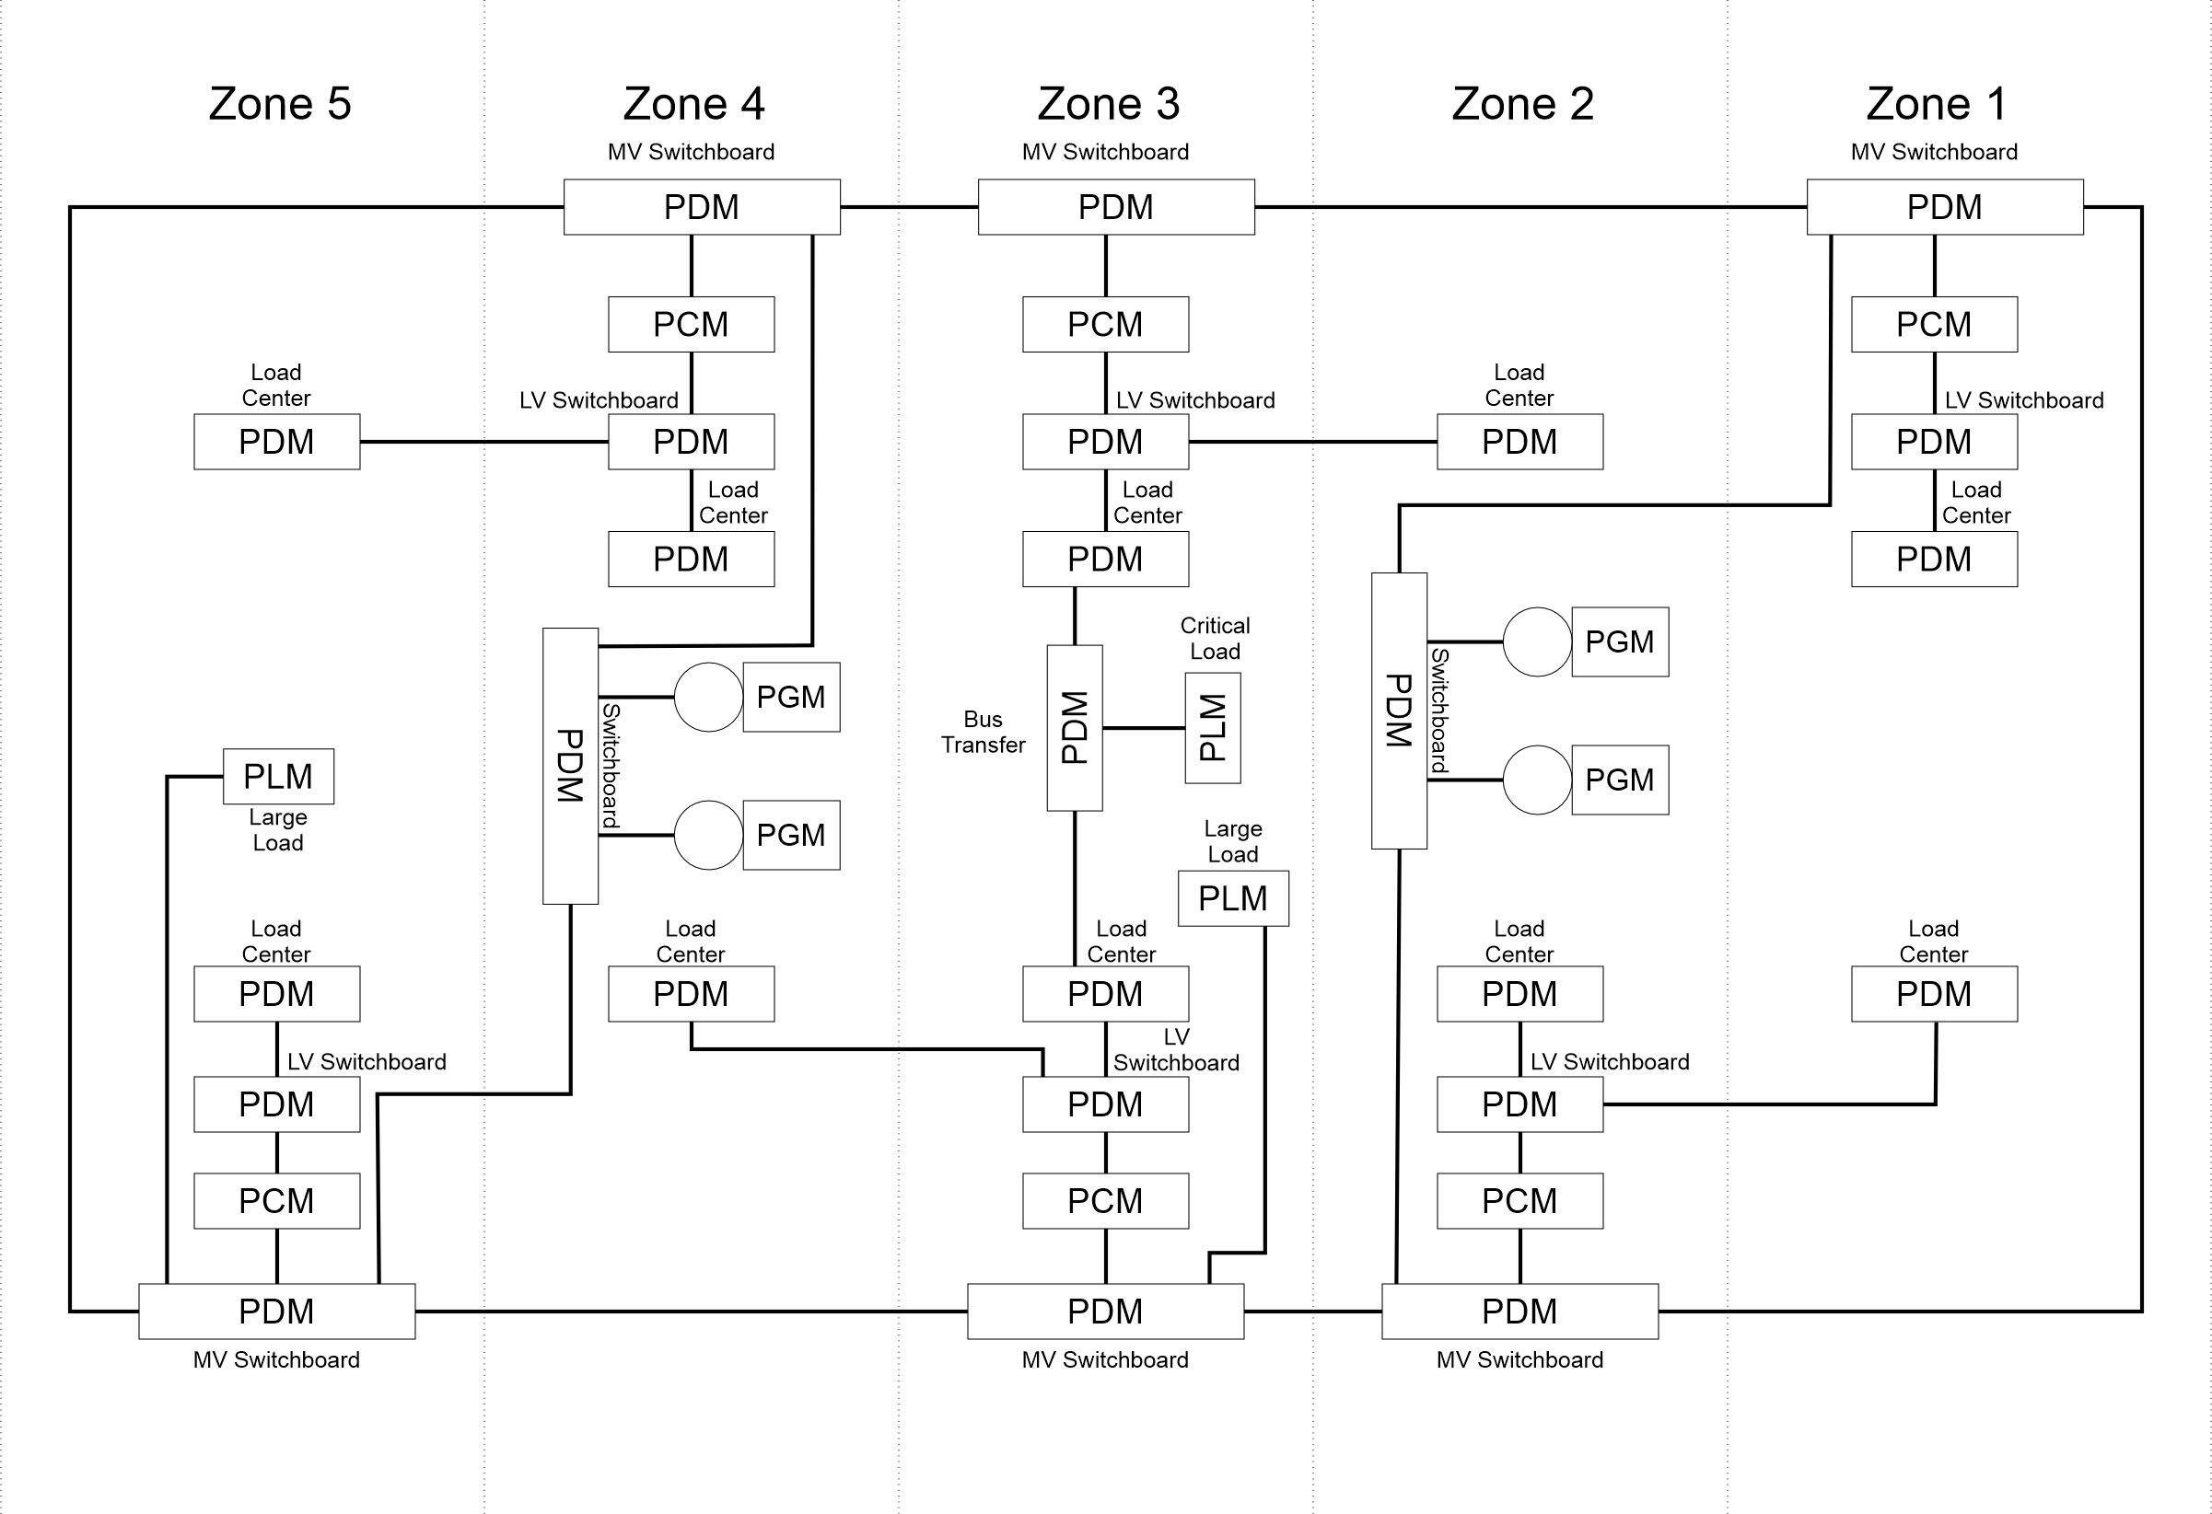
Introduction
Radial
Which Architecture to choose?
  The architecture that best meets all the customer requirements.
What is needed?
  Definition of customer requirements
  Definition of what is meant by “best”
  A means for evaluating a proposed architecture
    Does it meet customer requirements?
    Is it the best?
Ring Bus
Zonal

Slide 4
Stages of Design
Concept Design
  Products
    Set of requirements.
    Evaluation of the mission effectiveness of a ship that meets the requirements.
    Estimated acquisition and life cycle costs.
  Usually do not need to select an architecture to create products.
    Eliminate architectures likely not feasible or highly dominated by other architectures.
Preliminary – Contract Design
  Product
    Shipbuilding specification (part of contract between shipbuilder and owner).
  Usually select the architecture based on trade-studies
    May leave the choice to shipbuilder in detail design.
Detail Design
  Product
    Design and engineering artifacts required to construct, test, and certify the ship.
  Shipbuilder Implements the chosen architecture.

Slide 5
Electrical Power System Architectures
Commercial Ships
  Radial Distribution with two or three generator switchboards.
    Includes emergency switchboard.
    Generator sets normally located near each other
      Except emergency generator
  Passenger ships required by SOLAS to have Safe Return to Port capability should consider ring buses and zonal architectures.
Naval Ships
  Smaller ships (including many international naval ships) may employ radial distribution.
  Others may employ ring buses.
    Increase survivability by limiting amount of system damage from non-overmatching threats.
  Larger ships may employ a zonal distribution system.
    Reduces overall system complexity
    May be less expensive due to reduced cable lengths for normal and alternate sources of power for mission critical equipment.

Slide 6
Bus Voltages
Buses should use a standard nominal system voltage.
  IEEE Std 45.1
  MIL-STD-1399 section 300.1 and section 300.2
Bus voltages depend on the electrical load estimate and load flow analysis.
  If the load flow results in a maximum current flow exceeding 4000 amps (assuming 0.8 power factor for a.c. systems), a higher voltage should be employed.
    Circuit breakers with ratings above 4000 amps are unavailable or very expensive.
  For U.S. naval ships, low voltage solutions employ 450 V a.c. three phase power.
    Usually, 450 volts a.c. is the best solution if the maximum margined ship service load with service life allowance is less than 5 MW (twice 2.5 MW for split plant operation).
    Above 10 MW, a medium voltage solution is usually required.
    Between 5 and 10 MW, a detailed load flow analysis should be conducted to determine the best voltage.

Slide 7
A.C. vs D.C. buses
Low voltage solutions
  A.C. solutions
    Traditional solution
    Large industrial base
  D.C. solutions (Primarily 1 kV)
    Improved fuel efficiency with diesel engines
    Easier integration with fuel cells and energy storage systems
    Better able to integrate large pulsed loads
    Smaller industrial base (but growing)
Medium voltage solutions
  A.C. solutions
    Traditional solution
    Large industrial base
  D.C. solutions
    Improved fuel efficiency with diesel engines
    Better able to integrate large pulsed loads
    Potentially better power quality and quality of service
    Very limited industrial base

Slide 8
Propulsion System Architecture
Major Drivers
  Sustained speed
    Typically limited to 50 MW per shaft (< 40 MW preferred).
  Endurance requirements
    High efficiency under endurance conditions is desirable.
  Operating profile
    High efficiency over operating profile is desirable.
  Survivability / redundancy requirements
    May require at least two shafts.
  Pollution requirements
    May limit fuels / prime movers employed.
  Environmental noise requirements
  Ice Breaking requirements
Opportunities
  Arrangement flexibility

Slide 9
Sustained Speed
Ships that operate much of their time at or near their sustained speed / service speed with low ship service loads.
  Mechanical drive propulsion with independent electrical power system often preferred option.
  Supplying power from Propulsion Derived Ship Service (PDSS) power system may be beneficial.
Ships that operate much of their time well below their sustained speed / service speed with low ship service loads.
  Mechanical drive propulsion with independent electrical power system often preferred option
  Employing a CODAG or CODOG configuration may be beneficial.
Ships with large ship service loads.
  Hybrid drives or Integrated power systems (IPS) may be beneficial.

Slide 10
Endurance Requirements
For fuel efficiency, diesels are often preferred for operation at speeds relevant for endurance fuel requirements.
  Diesel Mechanical
  CODAG or CODOG
  CODLAG or CODLOG (hybrid architectures)
  IPS using diesel generator sets
Gas turbines may be considered to achieve sustained speed requirements above the speeds relevant for endurance fuel requirements.
  Gas turbines are comparatively smaller and lighter weight for a given power level.
  Gas turbines usually are less fuel efficient than diesel engines.

Slide 11
Operating Profile
Ships with a large ship service load, particularly at low speeds
  IPS or hybrid architectures often beneficial.
  Propulsion able to take advantage of the “extra” N+1 generator set.
Ships with a small service load or operate most of the time near their sustained speed / service speed
  Mechanical drive often beneficial.
Ships operating much of their time below sustained speed / service speed
  CODAG or CODOG
  CODLAG or CODLOG (hybrid architectures)
  IPS

Slide 12
Survivability – Redundancy requirements
Ships without survivability or redundancy requirements
  Single shaft if shaft power less than about 40 MW (50 MW max)
Ships with survivability or redundancy requirements
  Twin (or more) shafts
  Possible forward drop down propulsor
  Use of Azimuthing drives (pods)

Slide 13
Pollution Requirements
MARPOL emission limitations
  Favors IPS architectures
    Some ferries exclusively use electricity
  Favors use of alternate fuels

Slide 14
Environmental Noise Requirements
Commercial ships
  Cruise ships operating in environmentally protected areas
  Maritime research ships
Naval ships
  Reduce susceptibility from underwater attack.
IPS propulsion motors typically quieter than mechanical drive alternatives.

Slide 15
Ice breaking requirements
Ice breakers typically employ IPS:
  Better maneuverability
  Better torque for breaking ice
  High efficiency through optimal loading of generator sets.
Ice breakers increasingly using azimuthing thrusters (pods) as part of an IPS.
  Better maneuverability

Slide 16
Opportunities
Arrangement Flexibility
  Locate prime movers away from the shaft line
  Shorten shaft lines
  Maximize revenue generating spaces (cruise ships – staterooms)
  Enable more efficient modular construction

